Slide 1


DEEP LEARNING FOR AN 11-YEAR-OLD
Teaching a Robot How to Learn Using Gradient Descent
Team 4:
Oman, Phillip, Tien & Lufei
.

Slide 2
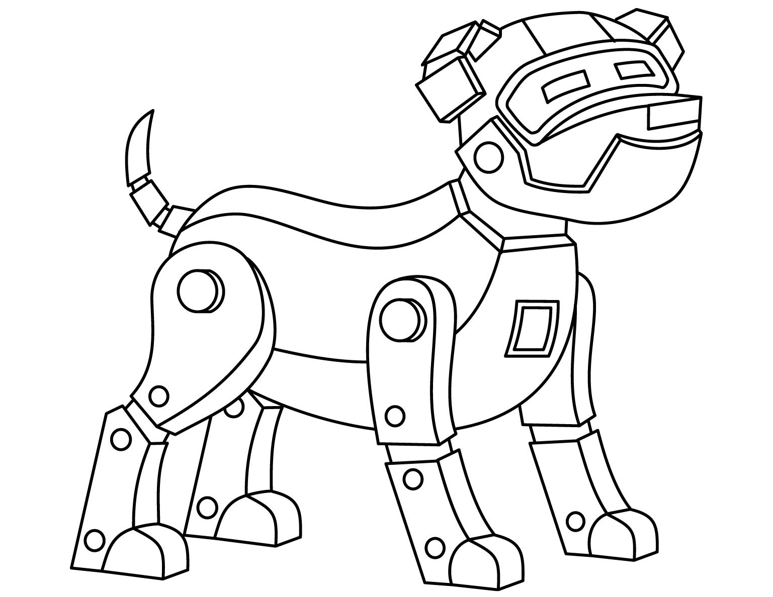
Introduction
Deep Learning is a way computers learn from data, similar to how humans learn from experience. Instead of being programmed with exact answers, computers learn by making mistakes and improving over time.
One of the most important ideas that makes Deep Learning work is called Gradient Descent.
This presentation explains Gradient Descent in a simple and creative way that an 11-year-old can understand.

Slide 3
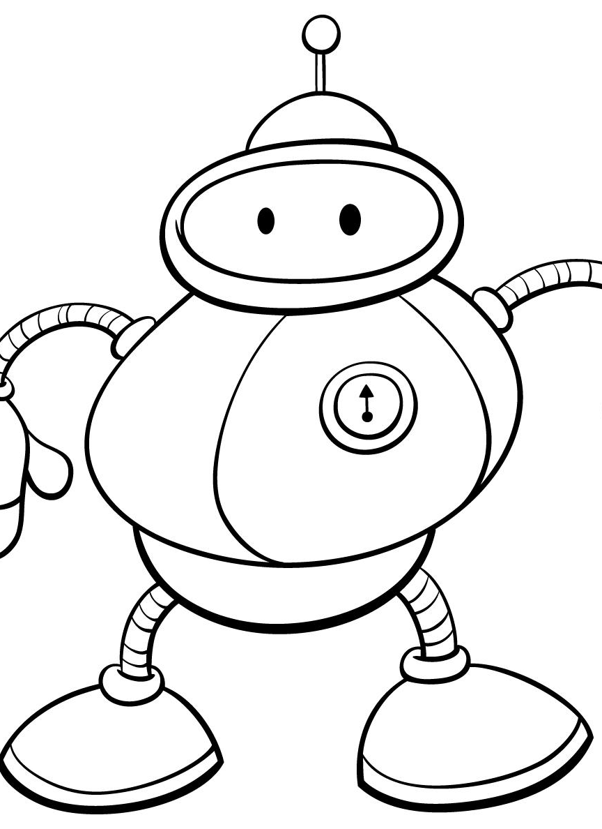
What Is Gradient Descent?
Gradient Descent is a learning method used by computers to reduce mistakes step by step.
In simple terms:
The computer makes a guess
It checks how wrong the guess is
It makes a small change to improve
It repeats this process many times
Each step helps the computer learn a little more.

Slide 4
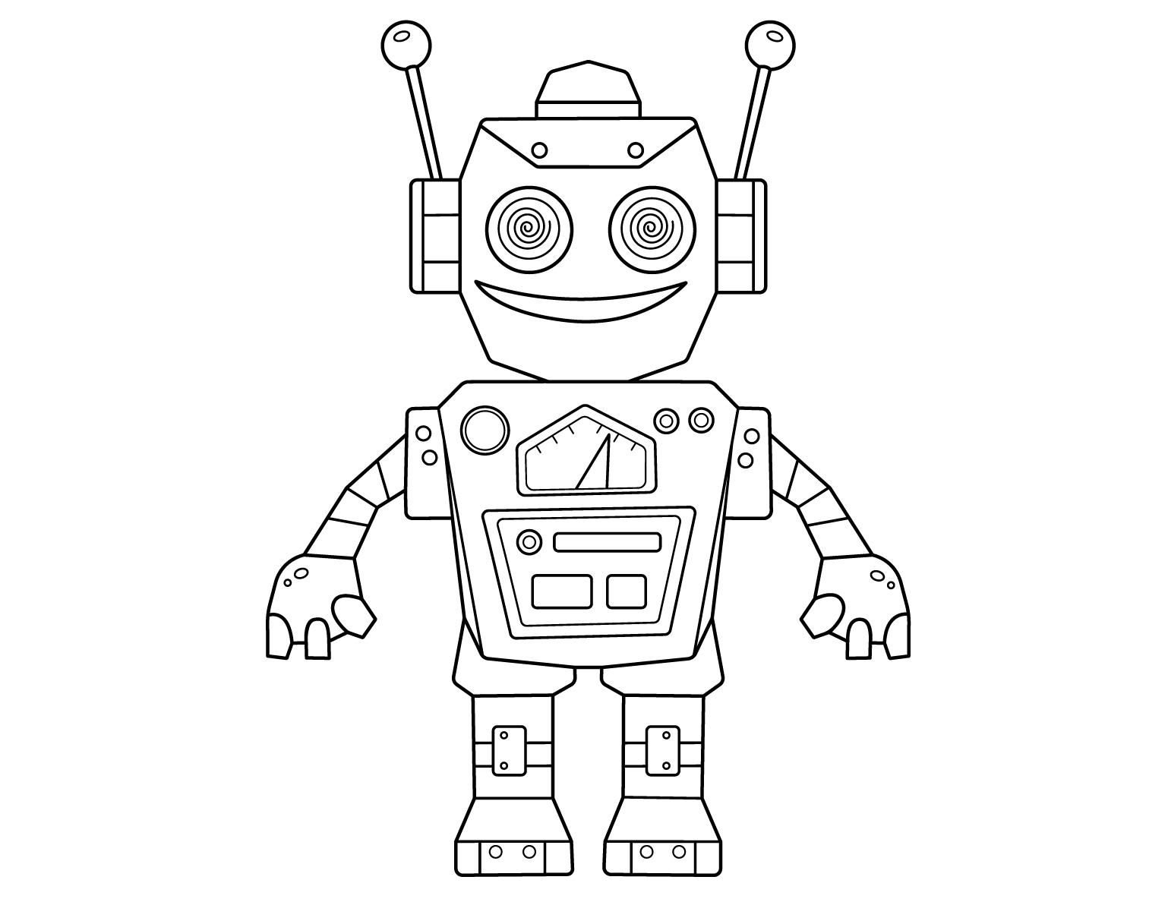
The Hill Story
Imagine a robot standing on top of a hill while wearing a blindfold. The robot’s goal is to reach the lowest point of the hill.
In this story:
The hill represents mistakes
Being high up means lots of mistakes
The lowest point means very few mistakes
Moving down the hill means learning
This is how Gradient Descent works in Deep Learning.

Slide 5
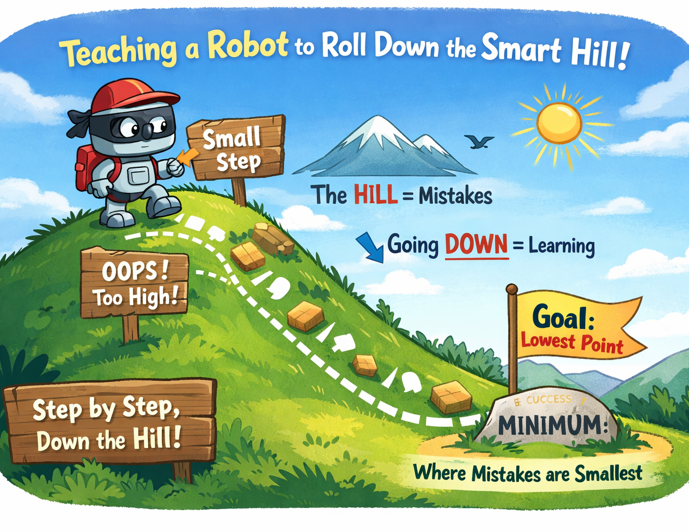

Slide 6
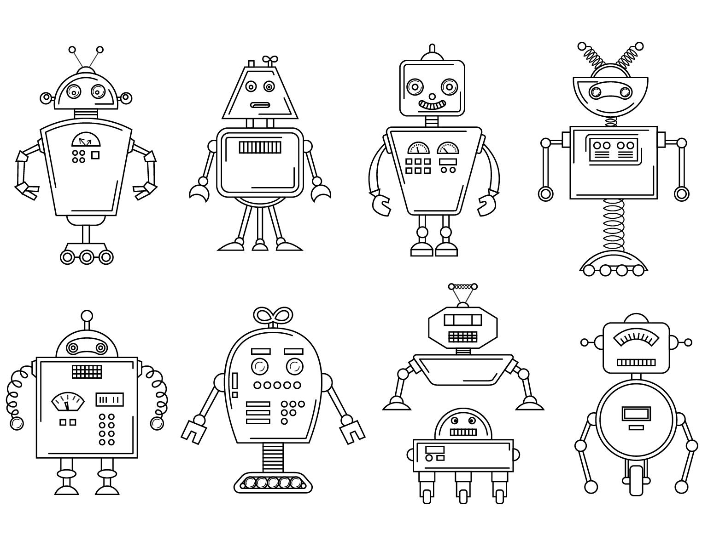
Why the Robot Takes Small Steps
The robot cannot see the hill, so it must move carefully.
If the robot takes big jumps:
It could miss the lowest point
It could jump past the correct answer
It may never stop making mistakes
Instead, the robot takes small steps, checking the ground each time.
This helps learning stay safe and accurate.

Slide 7
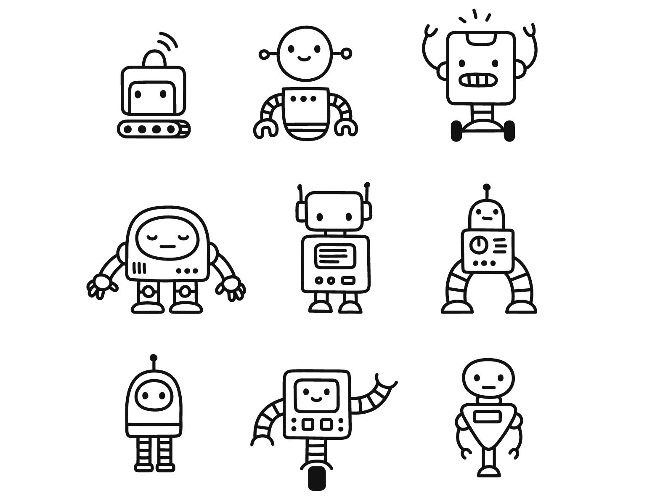
Learning Rate
The size of each step is controlled by something called the learning rate.
A small learning rate means learning slowly but safely
A large learning rate means learning faster but with more risk
Choosing the right learning rate helps the computer learn efficiently without failing.

Slide 8
How Gradient Descent Works Step by Step
The model starts with random values
It makes a prediction
The error is calculated (called loss)
Gradient Descent finds the direction that reduces error
The model updates itself slightly
The process repeats many times
Over time, the errors become smaller and smaller.

Slide 9
The Math Idea
Gradient Descent is based on math, but the idea is simple.
Gradient means direction and slope
Descent means moving downward
The algorithm always moves in the direction that lowers mistakes the most while keeping steps small.

Slide 10
Real-Life Example
Imagine practicing basketball free throws.
First try: you miss
Second try: you adjust your aim
Third try: you improve again
After many tries: you score more often
Each small adjustment helps you get better.
This is exactly how Gradient Descent helps computers learn.

Slide 11
Why Gradient Descent Is Important
Gradient Descent is used in almost all Deep Learning systems.
It helps power:
Image recognition
Speech recognition
Recommendation systems
Self-driving cars
Medical image analysis
Without Gradient Descent, neural networks would not be able to learn.

Slide 12
Strengths of Gradient Descent
Works well with large amounts of data
Can handle complex neural networks
Improves models step by step
Scales to real-world AI problems
These strengths make Gradient Descent the backbone of modern AI.

Slide 13
Limitations of Gradient Descent
Can get stuck in local minimums
Needs careful tuning of the learning rate
Can be slow for very large models
Sensitive to noisy or poor-quality data
Even with these limits, it is still the most widely used learning method.

Slide 14
Final Summary
Gradient Descent is a method that helps computers learn by reducing mistakes little by little.
Using the hill analogy:
Mistakes are the height of the hill
Learning means moving downward
Small steps prevent failure
The goal is the lowest point where mistakes are smallest
This process allows machines to learn effectively and improve over time.

Slide 15
References
Goodfellow, I., Bengio, Y., & Courville, A. (2016). Deep Learning. MIT Press.
Khan Academy. Gradient Descent in Machine Learning.
3Blue1Brown. Gradient Descent – How Neural Networks Learn.
IBM. What Is Gradient Descent?

